Slide 1
Forces, Gravity, and
the Physics Engine
What happens when you stop moving objects yourself, and hand the job to Unity's physics engine instead?
F = ma
today's central equation

Slide 2
WARM-UP
Two Balls. Same Drop. Different Reasons.
Watch both objects fall in the same scene. They look almost identical for the first second — but only one of them is obeying physics.
BALL A
BALL B
Moved by a script
Moved by physics
Every frame, code tells it exactly where to go:
transform.Translate(Vector3.down * speed * Time.deltaTime)
Has a Rigidbody component. No movement code at all —
just gravity, turned on.
Falls at a constant rate. Stops exactly at the height the script says. Ignores anything in its path.
Accelerates as it falls. Reacts if something is in its way. Its path is calculated, not scripted.
Today's question: what happens when you hand motion over to the physics engine — and what do you gain and lose by doing it?
2

Slide 3
VOCABULARY
Two Kinds of Motion
Every object in your Unity scene moves one of these two ways. There's no third option.
DYNAMIC MOTION
KINEMATIC MOTION
“Physics-driven” motion
“Scripted” motion
You apply a force (a push), and the Rigidbody component figures out the motion.
Position emerges from mass, drag, and gravity — you don't set it directly.
This is how real-world motion actually works.
You directly set position or rotation in code, frame by frame.
The object goes exactly where you tell it — always.
Physics (gravity, collisions, forces) is ignored.

Slide 4
THE PHYSICS
The Law Every Physics Engine Runs On
Unity's Rigidbody doesn't invent new physics. It runs the same law your science class already covers — over and over, every fraction of a second.
F = m a
F
m
a
Force
Mass
Acceleration
The push or pull you apply — in Unity, this is what AddForce() sends.
How much “stuff” the object has — set on the Rigidbody's Mass field.
How quickly velocity changes — the result the engine calculates for you.

Slide 5
PREDICT IT
Same Push. Different Mass. What Happens?
Rearrange the formula to see what the engine actually computes each step:
a = F / m
Same AddForce() call.
Two different Rigidbody masses.
Two completely different trajectories: that's F = ma running under the hood, every single physics step.
large acceleration → flies far
LIGHT BOX
mass = 1
small acceleration → barely moves
HEAVY BOX
mass = 5

Slide 6
THE COMPONENT
Meet the Rigidbody
Add this one component and Unity's physics engine takes over. Three fields matter most today:
▣ Rigidbody
Mass
Heavier objects need more force to reach the same acceleration (a = F/m).
Mass
1
Drag
0
Drag
Simulates air resistance — higher drag slows an object down over time, even with no other forces.
Angular Drag
0.05
Use Gravity
✓
Use Gravity
Is Kinematic
☐
Uncheck this and Physics.gravity no longer pulls the object down — useful for the gravity-scale trick later today.

Slide 7
THE CODE
AddForce(): Handing Off the Push
public float launchForce = 500f;
private Rigidbody rb;
void Start()
{
rb = GetComponent<Rigidbody>();
}
public void Launch(Vector3 direction)
{
rb.AddForce(direction * launchForce);
}
public float launchForce
A number you can tune live in the Inspector — no code changes needed to test a different force.
rb.AddForce( ... )
This does NOT move the object. It hands the engine a push — the Rigidbody's own mass decides the resulting acceleration.
direction * launchForce
A vector (direction) scaled by a number (force) — the same vector × scalar pattern from Week 3, applied to a push instead of a position.

Slide 8
UNDER THE HOOD
Why Physics Lives in FixedUpdate()
Update() runs once per rendered frame — and frame rate isn't the same on every computer. Physics can't work that way.
Update()
FixedUpdate()
Runs once per rendered frame.
Runs on a fixed timestep, no matter the frame rate.
30 fps computer → 30 calls/sec
144 fps computer → 144 calls/sec
Every machine → same physics step, every time
Good for: reading input. Bad for: physics — forces would land differently on every machine.
Good for: AddForce(), gravity, collisions — anything that must feel identical on every computer.

Slide 9
COMPUTATIONAL THINKING
A Simulation Is a Model, Not Magic
Unity isn't solving one perfect equation for your trajectory. It's taking thousands of tiny, simplified steps — and that's exactly what “simulation” means.
1
2
3
4
Read forces
acting right now
Compute change
in velocity (a = F/m)
Update position
using that velocity
Repeat next
FixedUpdate() tick
↻ This loop repeats dozens of times per second — the curve you see is thousands of tiny straight-line guesses, not one smooth calculus formula.

Slide 10

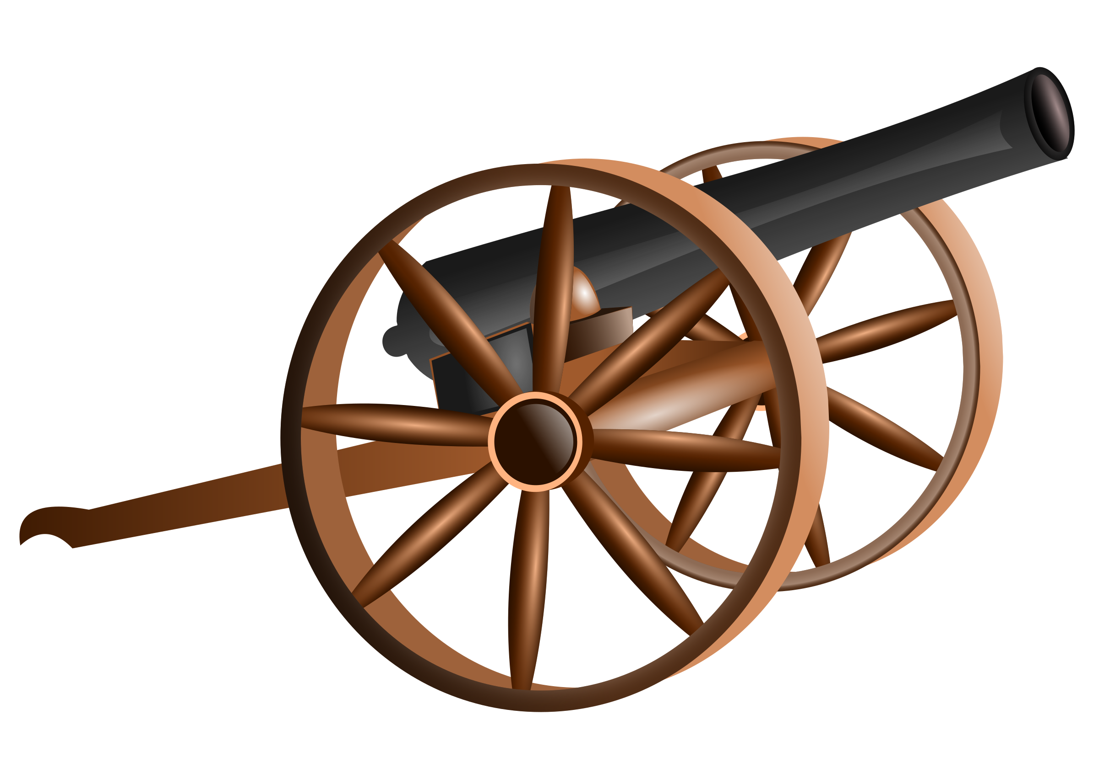
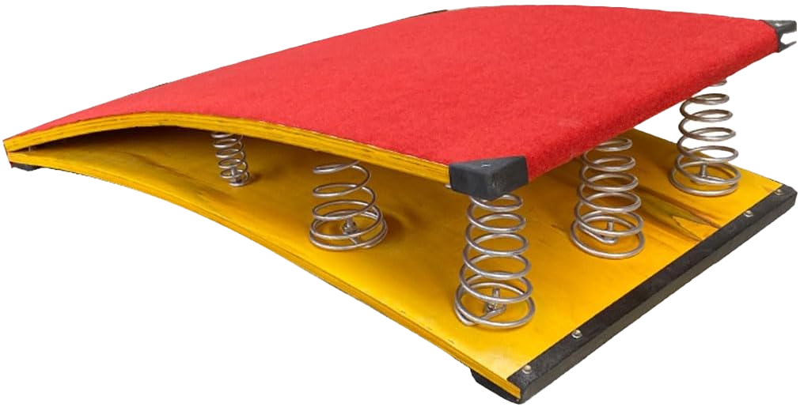
BUILD TIME
Today's Build: Choose Your Launcher
Every option needs the same thing underneath: a projectile with a Rigidbody, launched with AddForce().
Catapult
Cannon
Jump Pad
An arm rotates and flings the projectile forward on release.
A fixed barrel fires the projectile along one aimed direction.
The projectile bounces upward the instant it touches the pad.

Slide 11
THE EXPERIMENT RULE
Change ONE Thing at a Time
This is how scientists (and engineers) actually test ideas — and it's the difference between a real experiment and a random guess.
Changing everything at once
Changing one variable
Trial 2: force 500→800, mass 1→3, gravity scale 1→0.5
Trial 2: force 500 (same), mass 1→3 (changed), gravity scale 1 (same)
The trajectory changed — but WHY? You can't tell which variable caused what. The data is useless.
Now any change in the trajectory can only be explained by mass — that's a real, defensible result.

Slide 12
PICK YOUR VARIABLE
Three Variables. Pick One Per Trial.
Bigger push, same mass → more acceleration, farther/higher trajectory.
Force
launchForce
Heavier object, same force → less acceleration, shorter/flatter trajectory.
Mass
rb.mass
Lower gravity → object hangs in the air longer and travels farther before landing.
Gravity Scale
custom multiplier

Slide 13
QUICK FIX
No “Gravity Scale” Field in 3D? Make One.
Unity's 2D Rigidbody has a Gravity Scale slider built in. The 3D Rigidbody doesn't — so we build the same idea ourselves.
public float gravityScale = 1f;
private Rigidbody rb;
void Start()
{
rb = GetComponent<Rigidbody>();
// turn off built-in gravity
rb.useGravity = false;
}
void FixedUpdate()
{
rb.AddForce(Physics.gravity
* gravityScale * rb.mass);
}
Why turn gravity off first?
If useGravity stays on, the object gets pulled down by Unity's built-in gravity AND your custom force — doubling up. Turning it off lets your gravityScale variable be the only source of ‘down.’
Try it: set gravityScale to 0.5 and predict the trajectory before you press Play.

Slide 14
DELIVERABLE
Your Mini-Lab Report
For each of your three trials, capture these four things — in order:
1
Hypothesis
Before you press Play: what do you predict will happen, and why?
2
Changed Variable
Name the ONE field you changed, and its old vs. new value.
3
Observed Result
Sketch, screenshot, or describe the trajectory shape you actually got.
4
F = ma Explanation
One sentence connecting what you saw back to force, mass, or acceleration.
Sentence starter: “I kept ___ the same and changed ___. Since a = F / m, the object should accelerate ___, which matches / doesn't match what I observed.”

Slide 15
COMMON BUG
Watch Out: The Rocket-Off-Screen Bug
If your launcher calls AddForce() every single frame instead of once, the force keeps stacking — and your projectile leaves the map.
BUGGY
FIXED
void FixedUpdate()
{
rb.AddForce(Vector3.forward * launchForce);
}
// applies force EVERY tick, forever
void OnLaunchButtonPressed()
{
rb.AddForce(Vector3.forward * launchForce);
}
// applies force ONCE, on trigger
Fix it: gate the call behind an input check or a one-time Launch() method — never leave AddForce() unconditional inside Update() or FixedUpdate().

Slide 16
EXIT TICKET
Before You Go...
Fill in the blank: If I keep force the same but double an object's mass, its acceleration will ___ (increase / decrease / stay the same) — because a = F / m.
Predict: If Unity calculated position with one giant calculus formula instead of tiny FixedUpdate() steps, would the ball's landing spot change? Why do simulations use small steps instead?

